Slide 1
Purity Enhancement from Athermaility Enhancement
arXiv:2506.10059
Jake Xuereb, Benjamin Stratton, Alberto Rolandi, Jinming He, Marcus Huber, Pharnam Bakhshinezhad
arXiv:2409.12759
Chung-Yun Hsieh, Benjamin Stratton, Hao-Cheng Weng, Valerio Scarani

Slide 2
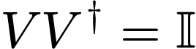
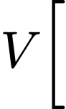
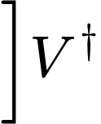
Aim
Given n arbitrary states
Increase the purity here
Understand by how much I can increase the purity
Understand the dynamics that will achieve it

Slide 3
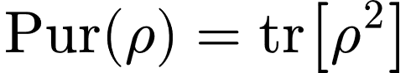
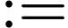
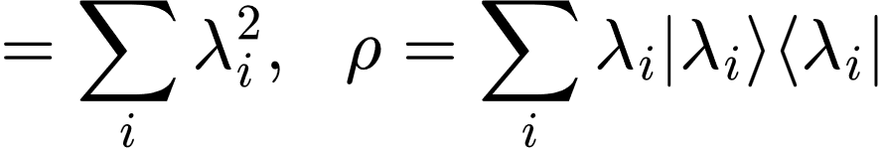
Purity
The purity of a quantum state is a measure of how mixed the state is.
Given by
Broadly considered a resource across quantum technologies.
Incentivised to increase the amount we have

Slide 4
We developed a framework for purity enhancement by considering: athermaility enhancement

Slide 5
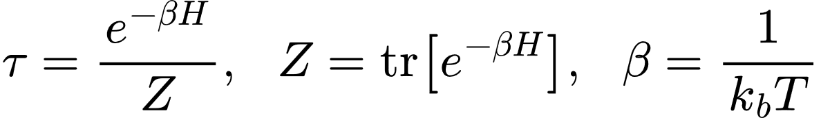
Athermaility
A measure of “how far” a state is from a thermal state:
A multitude of different methods for numerically measuring athermaility.
Considered a resource in the resource theory of thermodynamics.

Slide 6
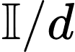
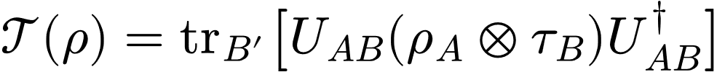
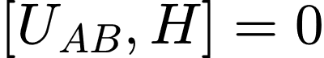
Purity vs Athermaility
Free States
Allowed Operations
Purity
Athermaility

Slide 7
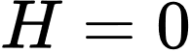
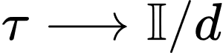
Athermaility Purity
Mathematically, purity can be seen to be a special case of the resource theory of thermodynamics. If
Allows the informational contributions to thermodynamics to be isolated from the energetic ones.
Resource theory of informational non-equilibrium
such that
Notes:
Noisy operations are a strict subset of unital operations. But there exists a noisy operation between two states if and only if there also exists a unital operation between them too.

Slide 8
Purity and athermaility are distinct resource
But they coincide in a specific regime
Understanding how to enhance one might inform us as to how to enhance the other.

Slide 9
Cooling Thermal States via Unitary Dynamics
arXiv:2506.10059
Jake Xuereb, Benjamin Stratton, Alberto Rolandi, Jinming He, Marcus Huber, Pharnam Bakhshinezhad

Slide 10
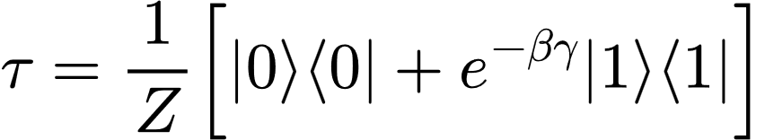
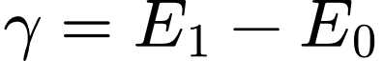
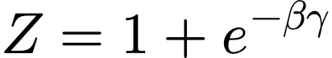
What does it mean to cool a qubit?
Cooling means decreasing the temperature
Define temperature via the Gibbs state
For qubits:
:

Slide 11
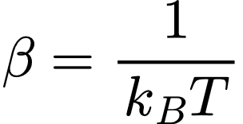
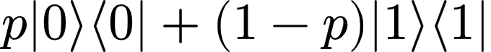
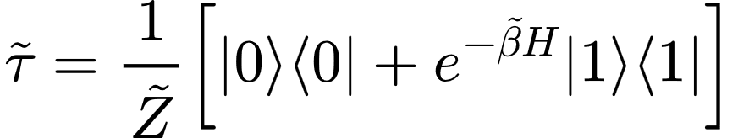
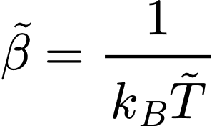
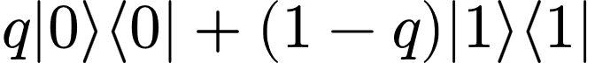
What does it mean to cool a qubit?

Slide 12
Increasing its ground state population
Cooling a qubit therefore means:
or Increasing its maximum eigenvalue (assuming the state is diagonal in the energy eigenbasis)

Slide 13
The new temperature is an effective temperature State has been driven away from the thermal state
Cooling is a type of increasing athermaility

Slide 14
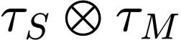
Setup
System
Machine

Slide 15
Setup
Machine
System

Slide 16
Setup
qubit
qubit
qubit
qubit
qubit

Slide 17
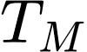
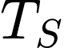
Setup
At temperature
At temperature

Slide 18
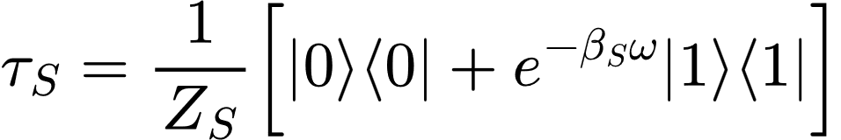
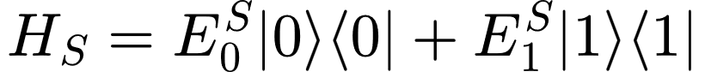
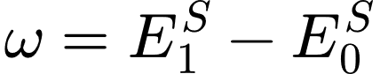
Setup
:

Slide 19
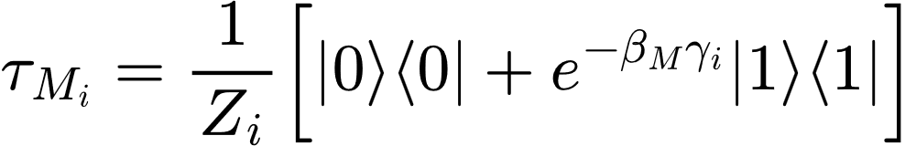
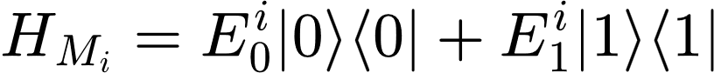
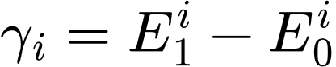
Setup
:

Slide 20
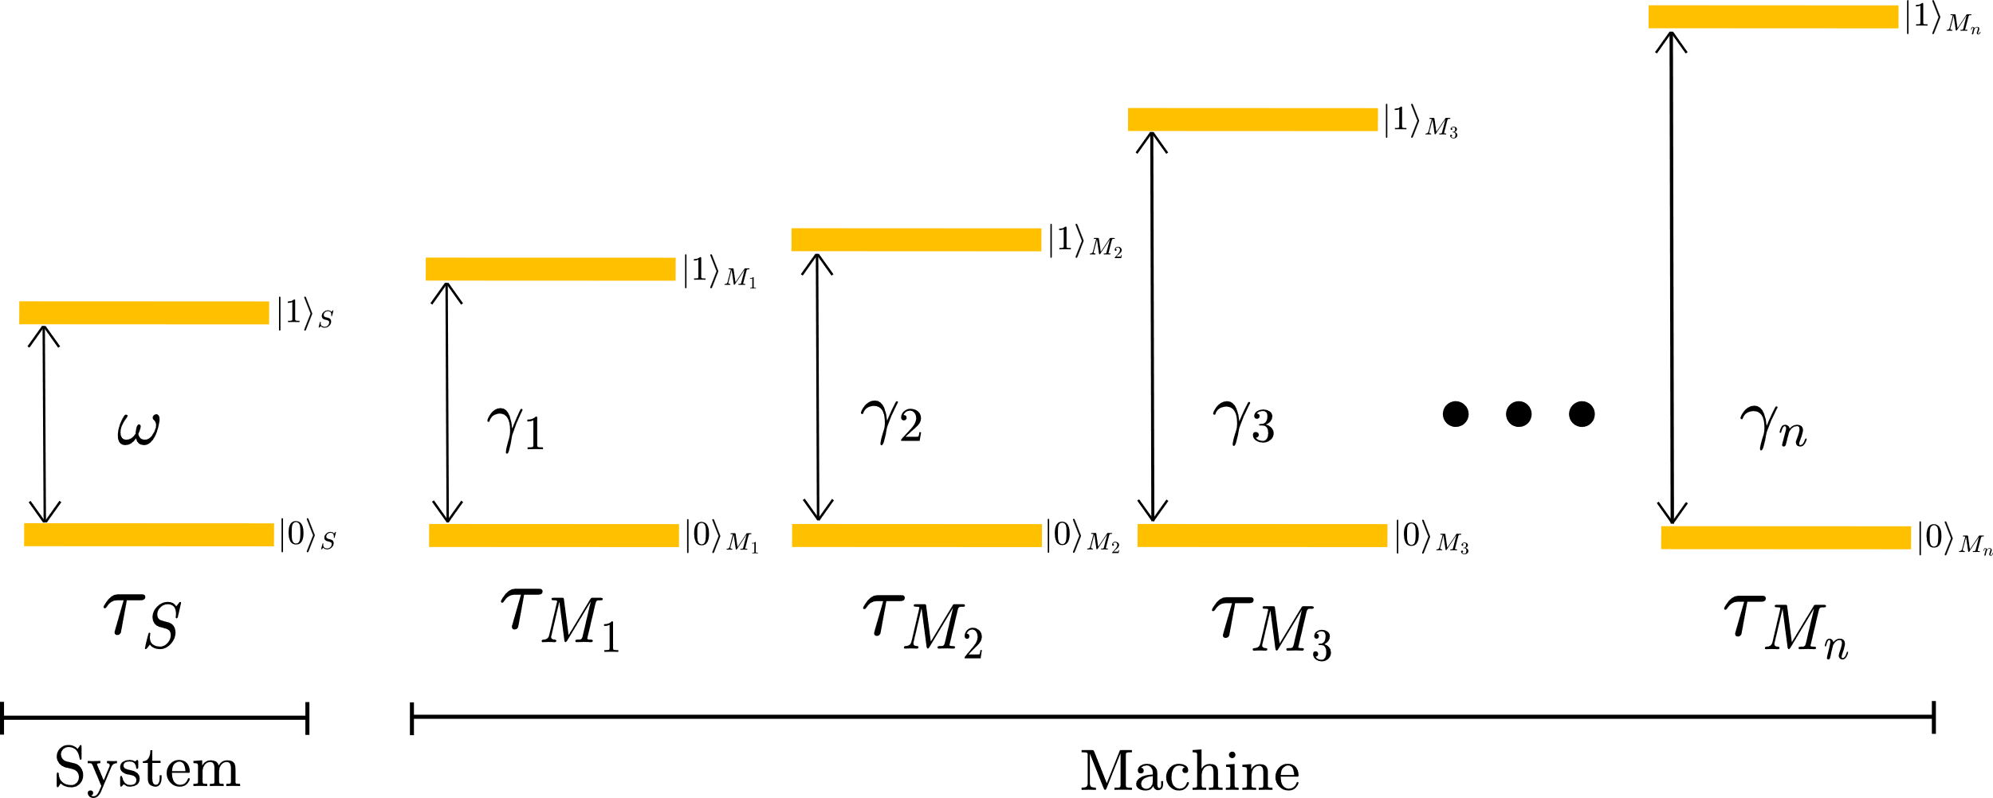
Setup

Slide 21
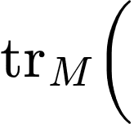
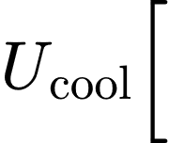
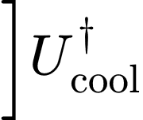

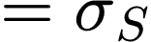
Aim
1. Apply a global unitary to all states,
2. Trace out machine
3. Is colder than ?
Has the ground state population been increased

Slide 22
Aside on Dynamics – Permutations
We are considering cooling via any unitary. However:
Initial State: diagonal in the energy eigenbasis
Can optimally increase the ground state population such that
Final State: diagonal in the energy eigenbasis

Slide 23
Aside on Dynamics – Permutations
We are considering cooling via any unitary. However:
Initial State: diagonal in the energy eigenbasis
Sufficient to consider just permutations of the energy eigenbasis
All permutations can be considered as a product of two-level permutations
Final State: diagonal in the energy eigenbasis

Slide 24
Finding a set of two-level permutations that assign the maximum populations of the global state to the basis states that contribute to the local ground state population
Optimally Cooling the system qubit therefore means:

Slide 25
Motivation for this problem
Cooling is a fundamental task in thermodynamics.
In the past, identical qubits and asymptotic limits considered.
Here, we have considered finite machines with non-identical qubits.
Subroutine of Algorithmic cooling.
The “entropy compression” step
Method of performing state preparation

Slide 26
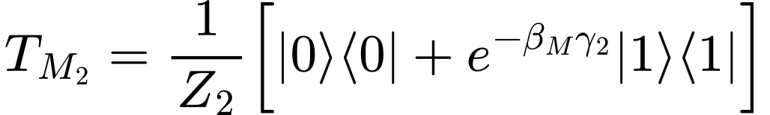
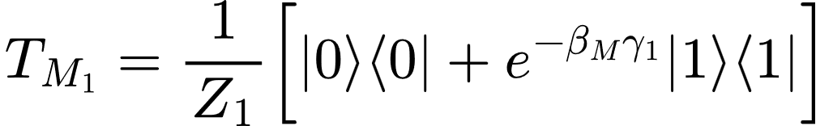
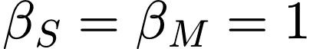
3 qubit example
Assume

Slide 27
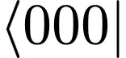
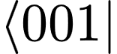
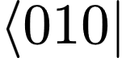
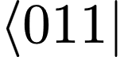
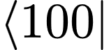
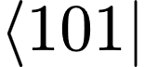
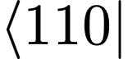
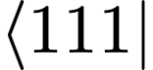
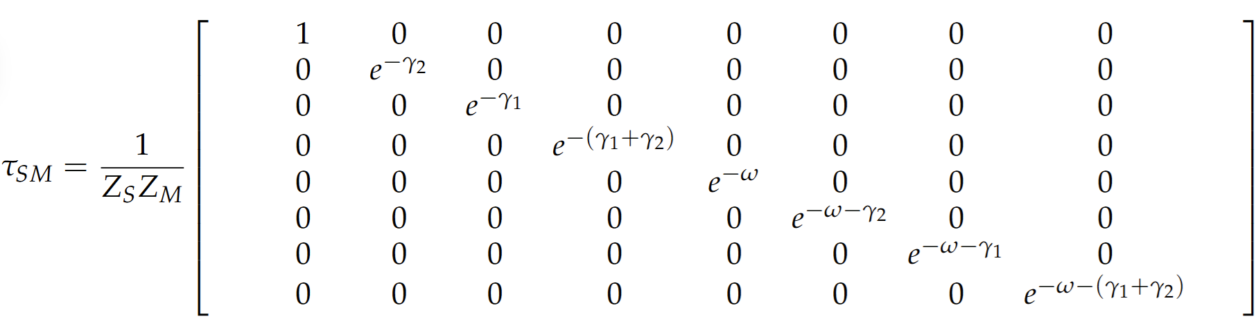
3 qubit example
Sum over these coefficients to give the ground state of the qubit
Optimal cooling via unitaries means finding the four largest populations and placing them here

Slide 28
Motivation for this problem
This is a solved problem
Quantum thermodynamic folklore says:
to cool a system S given access to an auxiliary machine M, one need only take their joint system and machine populations and reorder its eigenvalues in decreasing order.
This gives us no real insight into the cooling dynamics
Gives no insight into how the cooling depends on the energetic structure
(heuristically)

Slide 29
Motivation for this problem
In the past, identical qubits and asymptotic limits considered.
Here, we have considered finite machines with non-identical qubits.

Slide 30
3 qubit example

Slide 31
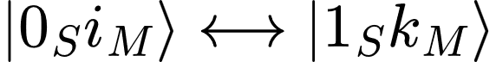
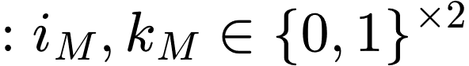
3 qubit example

Slide 32
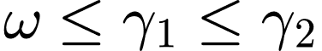
3 qubit example

Slide 33
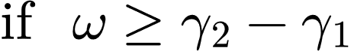
3 qubit example

Slide 34
3 qubit example
Four largest populations
Four smallest populations

Slide 35
3 qubit example
Apply
Performed optimal cooling
Four largest populations
Four smallest populations

Slide 36

3 qubit example

Slide 37
3 qubit example
Four largest populations
Four smallest populations

Slide 38
3 qubit example
Apply
Performed optimal cooling
Four largest populations
Four smallest populations

Slide 39
3 qubit example
Apply
Performed optimal cooling
Four largest populations
Four smallest populations

Slide 40

3 qubit example
Apply
Performed optimal cooling
Four largest populations
Four smallest populations

Slide 41


3 qubit example - Summary
Can cool to:
Greater ground state than “coldest qubit”
Required both qubits in the machine
Can cool to:
Cannot cool beyond “coldest qubit”
Required only 2nd machine qubit
The energetic structure of the machine dictates both:
How much the system can be cooled
The nature of the dynamics to perform that cooling

Slide 42


n-qubit Machines
Gap Vector

Slide 43
n-qubit Machines

Slide 44

n-qubit Machines
Ground state population of system

Slide 45



n-qubit Machines

Slide 46


n-qubit Machines
Type of permutation that can cool system

Slide 47
n-qubit Machines
Contributes to the ground state
Does not contribute to the ground state

Slide 48


n-qubit Machines
This permutation is cooling if:
Population of
Population of

Slide 49

n-qubit Machines
This permutation is cooling if:

Slide 50
How to find all the necessary permutations?
We considered the heuristic cooling algorithm already established in quantum thermodynamics

Slide 51

How to find all the necessary permutations?
Ordered vector of populations
Contributes to the ground state

Slide 52
How to find all the necessary permutations?
Ordered vector of populations
Do not contribute to the ground state

Slide 53









How to find all the necessary permutations?

Slide 54



How to find all the necessary permutations?

Slide 55
How to find all the necessary permutations?
Iteratively perform the permutations that give the maximum change in ground state population

Slide 56

How to find all the necessary permutations?
This algorithm outputs permutations of the form:

Slide 57
How to find all the necessary permutations?
This algorithm outputs permutations of the form:
Input these permutations into our equation to check if they are cooling.

Slide 58


How to find all the necessary permutations?
This permutation is cooling if:

Slide 59




Physical Interpretation
Minimum Machine Energy
Maximum Machine Energy

Slide 60

Physical Interpretation
Median Energy
Shifted Median
Notes:
If energy larger, population smaller. So swap the larger energy states with the smaller energy ones

Slide 61
All necessary permutations
Applying the following permutations will apply optimal cooling:
Calculate necessary permutations to optimally cool without finding the density operator

Slide 62

Optimal Cooling
The optimal change system ground state population is then:

Slide 63
The two-level permutations necessary for optimal cooling
With this framework we can calculate:
The optimal change in ground state population
without finding the density operator
What new can we learn from this framework?

Slide 64
What new can we learn from this framework?
Knowing just the temperatures and gaps, we can set lower bounds on the achievable cooling
We introduces and characterise the notion of reducibility
This determines when machines qubits make no contribution to the optimal cooling and can be removed
Introduces a framework with which we can perform an optimisation over the optimal cooling unitaries
Change in energy, gate complexity
Uses a minimum weight perfect matching.

Slide 65
Reducibility
Optimal Cooling with:
Is equivalent to optimal cooling with:
n-2 qubit machine

Slide 66
Reducibility
Maximum reducibility
(n-1)-reducibility

Slide 67

Reducibility
Maximum reducibility
(n-1)-reducibility
Minimum reducibility
Irreducibility
All qubits necessary

Slide 68
Midpoint Summary
Developed a framework to model cooling a thermal qubit given access to n-other thermal qubits and unitary operations
Looked at a “solved problem” with a new approach
Used this framework to gain a better understanding about the cooling dynamics
Created criteria to understand when certain machine qubits do not contribute to optimal cooling.

Slide 69
Cooling Thermal States via Unitary Dynamics
Purity Enhancement via Unitary Dynamics

Slide 70

Setup
System
Machine

Slide 71
Setup
Machine
System

Slide 72
Setup
qubit
qubit
qubit
qubit
qubit

Slide 73
Setup

Slide 74


Setup

Slide 75




Setup
Choose and
Need
And relabel machine qubits

Slide 76
Setup

Slide 77

Setup
Eigenbasis of system qubit

Slide 78
Setup
Contributes to the largest eigenvalue
Does not contribute to the largest eigenvalue

Slide 79

Setup
Eigenbasis of ‘i’ th machine qubit

Slide 80
Setup
This type of permutation will maximum eigenvalue of system qubit
Which is increasing purity

Slide 81
Why use this protocol?
All the results presented above will still apply
Can use the reducibility criteria to simplify the purifying unitaries

Slide 82
Is this optimal purity enhancement?
Already had the answer:
arXiv:2409.12759
Chung-Yun Hsieh, Benjamin Stratton, Hao-Cheng Weng, Valerio Scarani

Slide 83


Resource Concentration
Resource non-increasing
Maximally increase the resource in the A system
Two copies of the same state
Trace out B system

Slide 84


Resource Concentration
is a resource quantifier (a monotone)
Relocate resource from system B into system A using resource non-increasing operations

Slide 85
In this work, we considered concentration in the resource theory of informational non-equilibrium.
The resource theory of informational nonequilibrium in thermodynamics, Gour et al., Physics Reports, 2015

Slide 86
Informational Non-equilibrium
Colloquially: the resource (informational non-equilibrium) of a state is a measure of how “far” that state is from the maximally mixed state (the informational equilibrium state)
Allowed Operations Free States
Noisy Operations Maximally mixed state
We care about the subset of allowed operations that are unitary
Notes:
Noisy operations are a strict subset of unital operations. But there exists a noisy operation between two states if and only if there also exists a unital operation between them too.

Slide 87
Informational Non-equilibrium
Special case of the resource theory of thermodynamics
Allows the informational contributions to thermodynamics to be isolated from the energetic ones.
Mathematical simple and hence a good test bed for new ideas.
such that
Notes:
Noisy operations are a strict subset of unital operations. But there exists a noisy operation between two states if and only if there also exists a unital operation between them too.

Slide 88




Measuring Informational Non-equilibrium
Our
- Maximum Eigenvalue
Notes:
Noisy operations are a strict subset of unital operations. But there exists a noisy operation between two states if and only if there also exists a unital operation between them too.

Slide 89
Informational Non-equilibrium Concentration
Resource non-increasing
Two copies of the same state
This looks very similar to our other setup
Maximise the largest eigenvalue
Trace out B system

Slide 90


Informational Non-equilibrium Concentration
Sum over the -largest eigenvalues

Slide 91


Maximising Local Eigenvalue
Sum over the -largest eigenvalues

Slide 92


Maximising Local Eigenvalue
Sum over the -largest eigenvalues
This is exactly what our effective cooling algorithm achieves
Hence, our protocol optimally increases the maximum eigenvalue

Slide 93
For qubits Optimally increasing the maximum eigenvalue = Optimally increasing purity

Slide 94

Purity Increase

Slide 95
Purity Increase

Slide 96
Summary
Developed a framework for understanding optimally cooling thermal qubits using unitary operations
Cooling dynamics, amount of cooling achievable, and reducibility criteria
We used this framework to develop an optimal purity enhancement protocol

Slide 97


Future work
Higher dimensional systems
n-trit-strings and beyond?
Maximising largest eigenvalue optimal purity enhancement
,

Slide 98
Thank you
Cooling a Qubit using n Others, arXiv:2506.10059
Jake Xuereb, Benjamin Stratton, Alberto Rolandi, Jinming He, Marcus Huber, Pharnam Bakhshinezhad
Informational non-equilibrium concentration,
Phys. Rev. A 111, 052423
Chung-Yun Hsieh, Benjamin Stratton, Hao-Cheng Weng, Valerio Scarani

Slide 99

Minimum Weight Perfect Matching
Permute these
With these
Three ways to achieve it

Slide 100



Reducibility – Details
Exponential machines are always (n-1)-reducible:
:

Slide 101



Irreducibility – Details
(Most) Degenerate machines are always irreducible:

Slide 102

Cooling With Symmetries – Energy Conservation

